Slide 1

Tourism Experience Analytics
Enhancing traveler experiences through data-driven insights. This project classifies, predicts, and recommends.

Slide 2




Project Goals
Predict Ratings
Classify Visit Mode
Recommend Attractions
Predict user ratings for attractions (Regression).
Identify visit purpose (e.g., Family, Business).
Suggest tailored tourist attractions.

Slide 3

Business Use Cases
Personalized Recommendations
Suggest attractions based on user preferences.
Tourism Analytics
Analyze trends for strategic insights.
Customer Segmentation
Classify users for targeted marketing.
Customer Retention
Enhance loyalty with data-driven suggestions.

Slide 4

Dataset Overview
UserId
Unique user ID
Rating
User rating (1-5 scale)
AttractionType
Category of attraction
VisitMode
Purpose of visit
Attraction_Popularity
Average rating of attraction

Slide 5





Methodology: Data Processing
Data Import & Integration
Nine tables merged using pandas.
Data Cleaning
Removed insignificant columns, handled nulls, fixed duplicates.
Feature Engineering
Created User_Visit_Count, Avg_User_Rating, Attraction_Popularity.
Exploratory Data Analysis
Visual analysis of demographics, visit modes, ratings.

Slide 6
Exploratory Data Analysis Insights
User Demographics
Mode of Visit
Attraction Analysis
Asia and Australia are top tourism continents. Australia is the most visited country. Worrigee, Curepipe, and Kingscliff are highly rated cities.
Tour purpose varies by country. Couples prefer Western destinations. Business travel is limited overall.
Asian cities lead in attraction diversity. Nature and cultural attractions are most preferred. Top attractions dominate tourist flow.

Slide 7
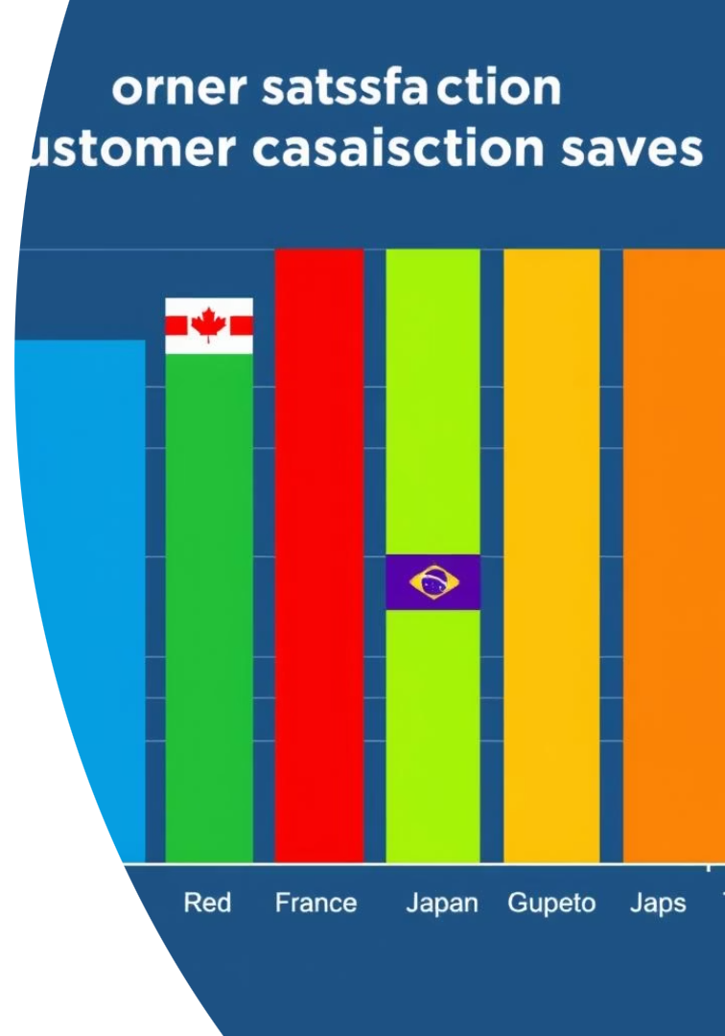




Rating Behavior & Visit Trends
High Satisfaction
Business Travelers Rate Higher
Low-Rated Countries
Most ratings are 5, indicating strong satisfaction.
Cuba, Monaco, Uruguay have lower average ratings.
Business travelers give higher average ratings.
Post-Pandemic Recovery
Tourist visits show recovery by 2022.

Slide 8
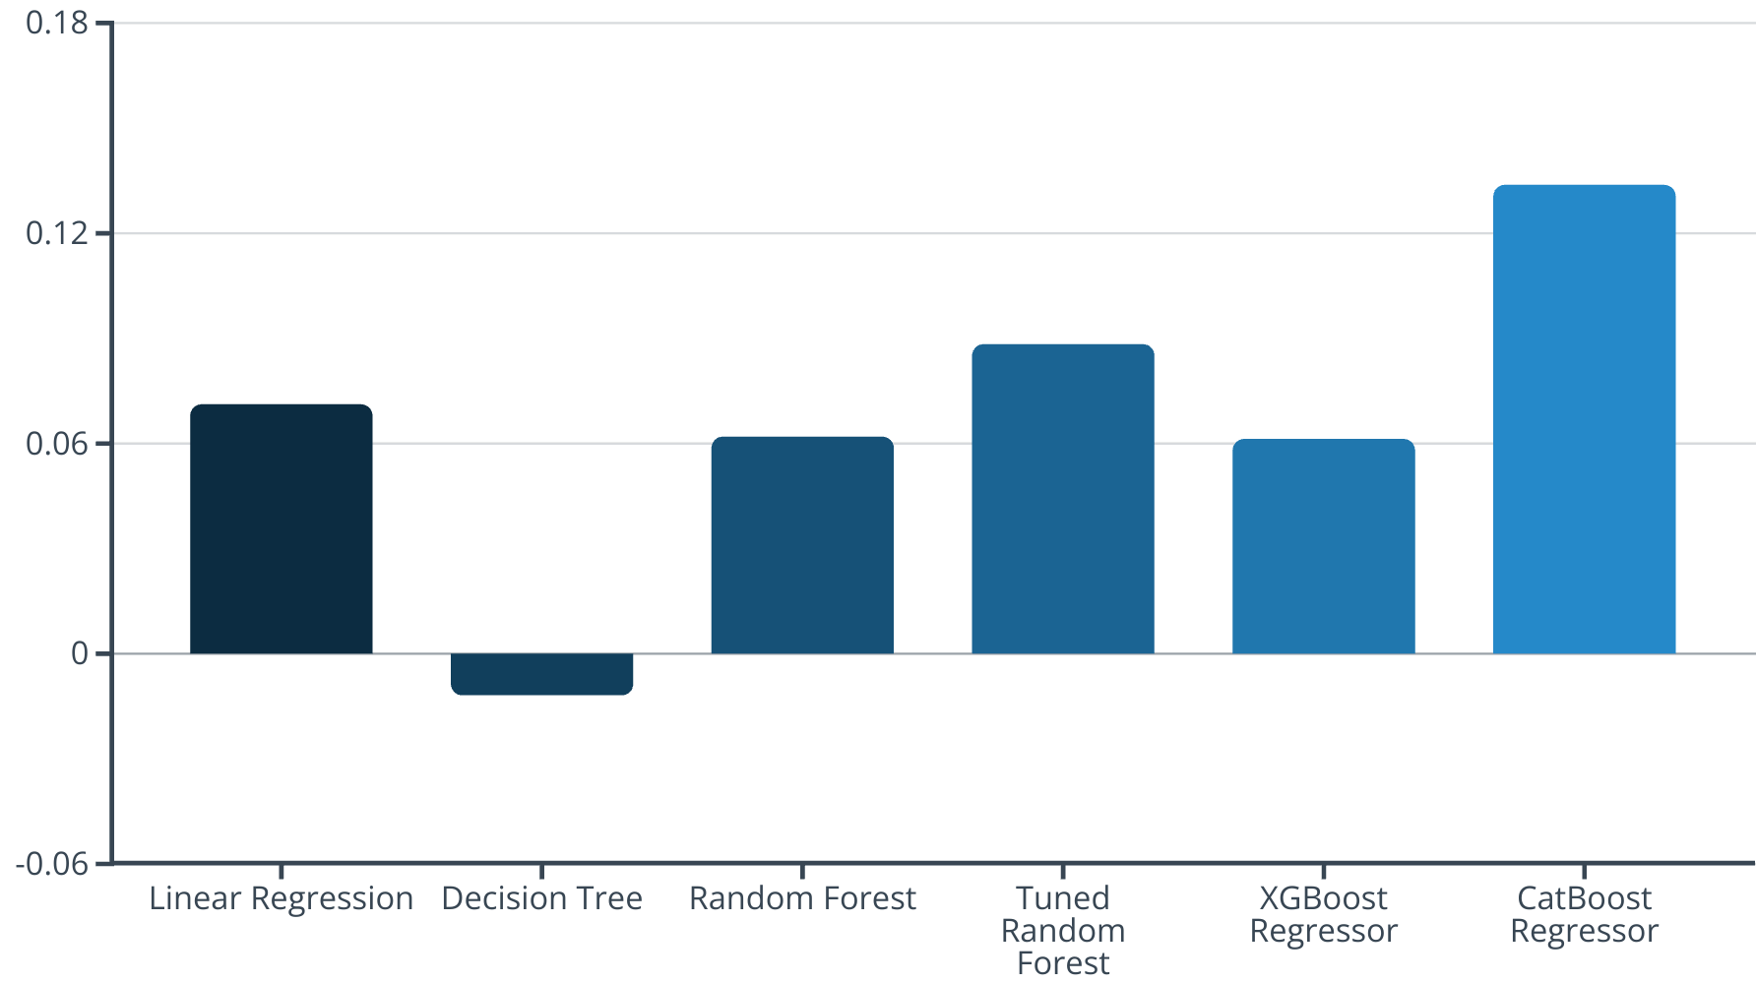
Predictive Modeling: Ratings
CatBoost Regressor performed best for rating prediction. Due to low R² scores, the problem was reframed to classification. CatBoost Classifier achieved 47.73% accuracy.

Slide 9
Predictive Modeling: Classification & Recommendation
Visit Mode Classification
Recommendation System
Random Forest Classifier achieved 47.89% accuracy. SMOTE was discarded due to reduced accuracy.
Uses Collaborative Filtering (kNN) based on user similarity and Content-Based Filtering using attraction features.

Slide 10
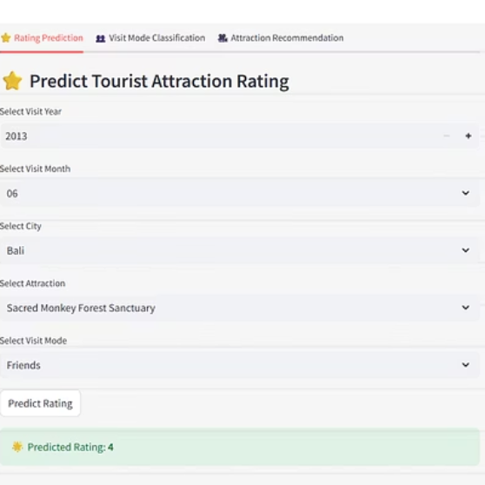
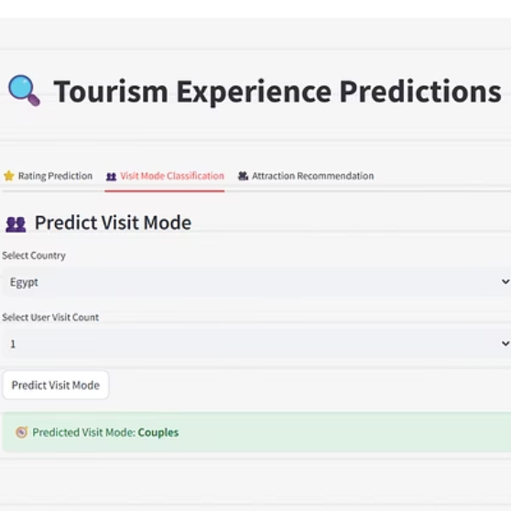
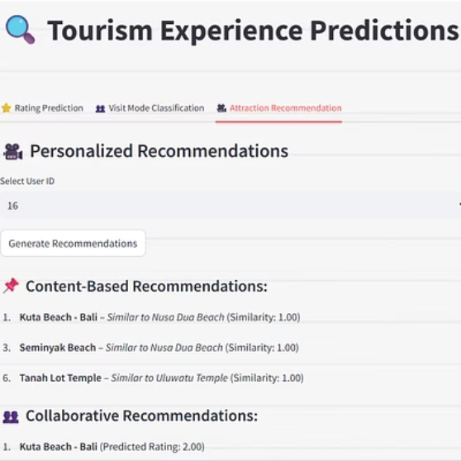
Streamlit App & Summary
The interactive Streamlit web app includes a visit mode predictor, attraction rating predictor, and personalized recommendations.

